Slide 1
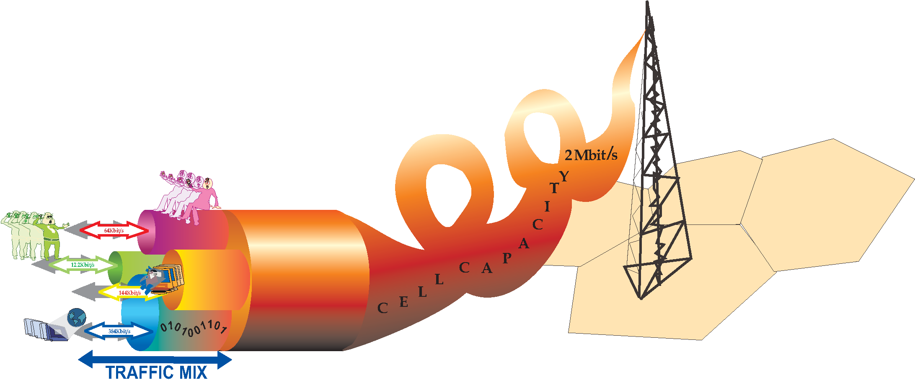
Mạng thông tin di động 3G
UMTS / W-CDMA
(Universal Mobile Telecommunications System)
High Speed Downlink Packet Access
(HSDPA)

Slide 2
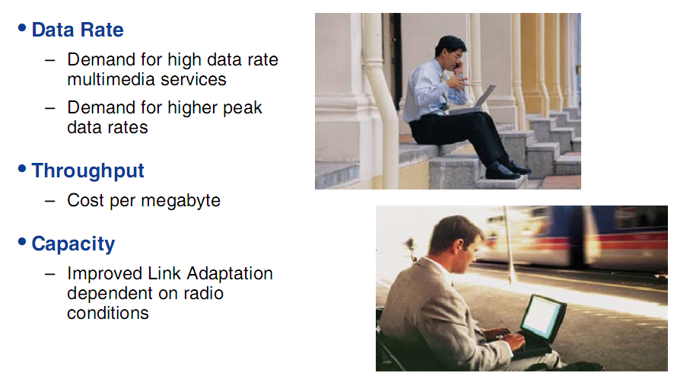
Motivations for migrating to HSDPA

Slide 3
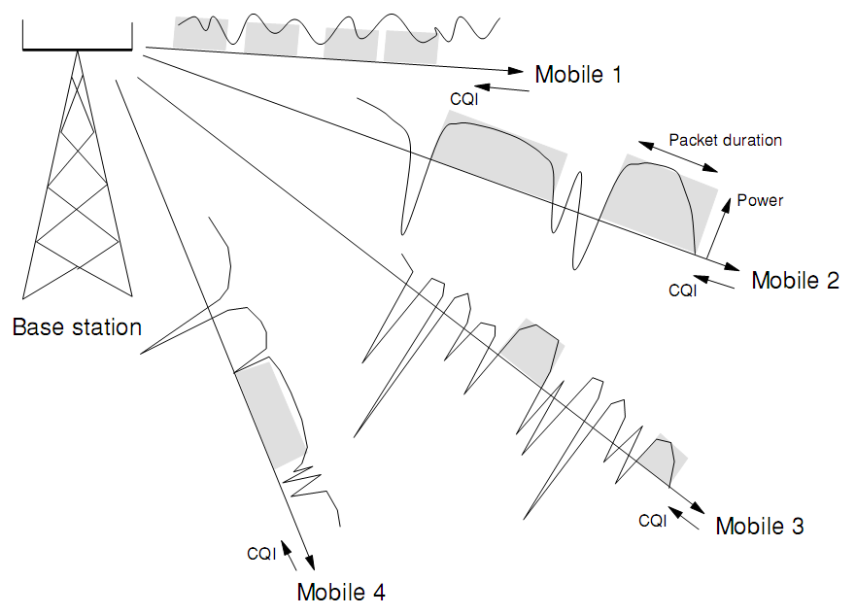
Multiuser diversity exploited in HSDPA
Node B

Slide 4
Introduction to HSDPA
HSDPA Improvements for packet data performance both in terms of capacity and practical bit rates are based on
  Higher order modulation
  Fast scheduling
  Shorter frame size (or transmission time interval)
  Physical layer retransmission
  The use of link adaptation
HSDPA does not support DCH features like fast power control or soft handover

Slide 5
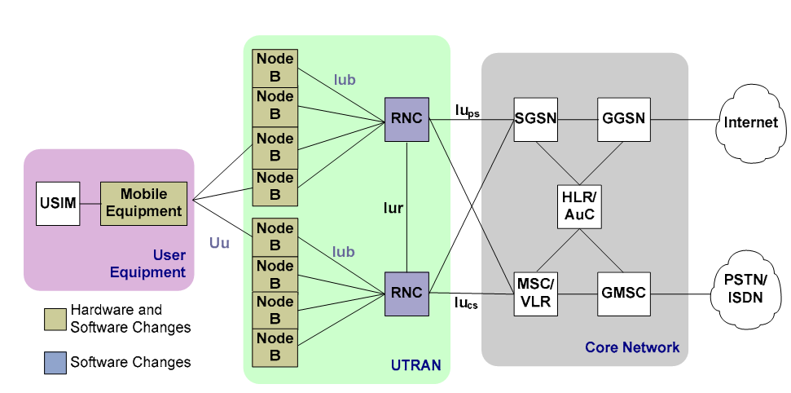
UMTS Network Architecture with HSDPA
Adding HSDPA to an existing UMTS network requires no new network entities.

Slide 6
UMTS Network Architecture with HSDPA
Hardware and/or software changes may be required for UE, Node B, and RNC. Interface changes are concentrated on the Uu and Iub
UE and Node B – Require hardware and software changes to support the new HSDPA channels and functionality.
RNC – Requires software changes to support new functionality and the new signaling messages used to configure and manage HSDPA channels.
Uu Interface – Requires new signaling messages exchanged over existing signaling channels and new transport and physical channels to support high-speed operation.
Iub Interface – Requires an updated frame protocol for sending high-speed user data from the RNC to the Node B.

Slide 7
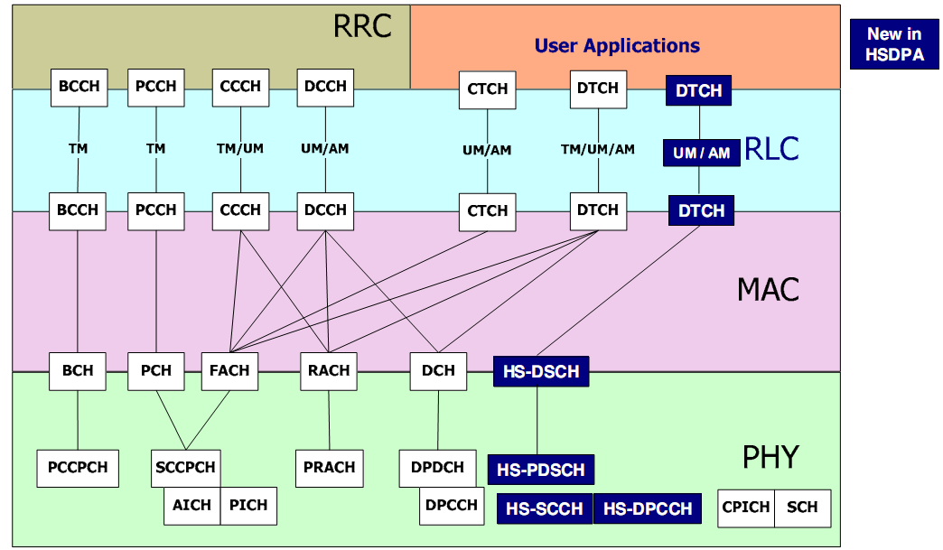
HSDPA channels

Slide 8
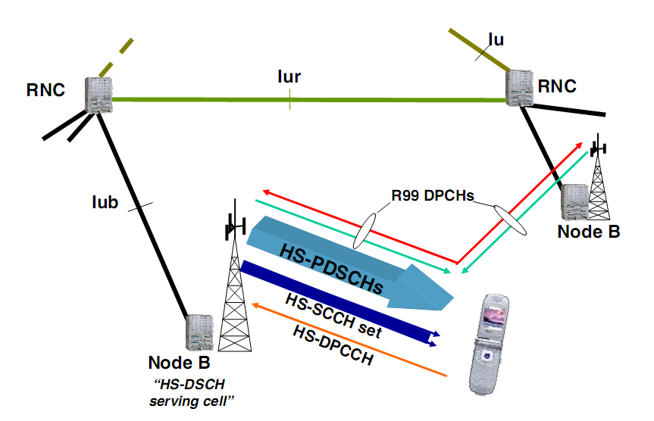
HSDPA channels
- HS-PDSCH (DL) – carries high speed user data shared by several UEs.
- HS-SCCH (DL) – carries control information for HSDPA use.
- HS-DPCCH (UL) – the HS-DPCCH caries UL feedback information including the HARQ feedback to indicate if the packet on the DL was received correctly. The HS-DPCCH runs in parallel with the R99 DPCHs that carry the DCH. This leaves the DCH operation unchanged and enables DCH operation in soft handoff.

Slide 9
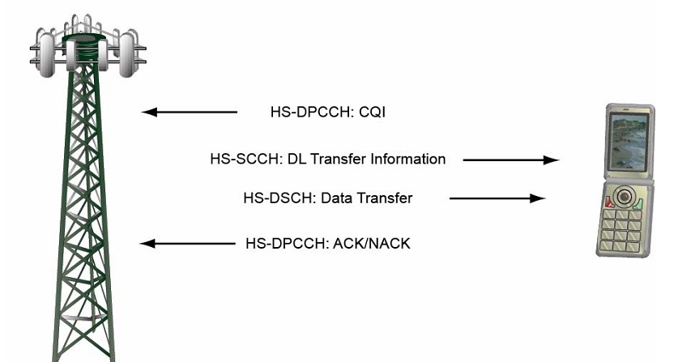
HSDPA channels
- HS-PDSCH (DL) – carries high speed user data shared by several UEs.
- HS-SCCH (DL) – carries control information for HSDPA use.
- HS-DPCCH (UL) – the HS-DPCCH caries UL feedback information including the HARQ feedback to indicate if the packet on the DL was received correctly. The HS-DPCCH runs in parallel with the R99 DPCHs that carry the DCH. This leaves the DCH operation unchanged and enables DCH operation in soft handoff.

Slide 10
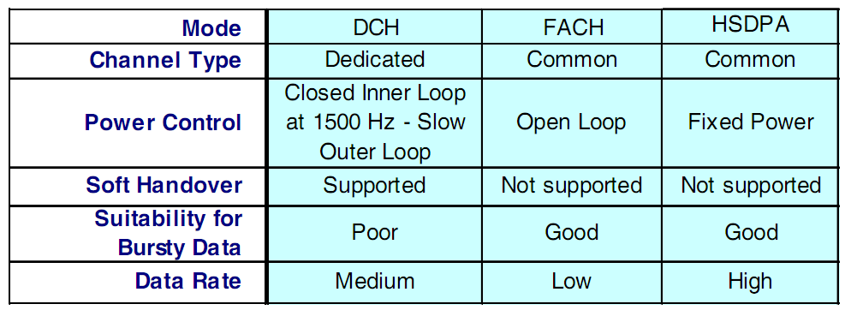
HSDPA channels

Slide 11
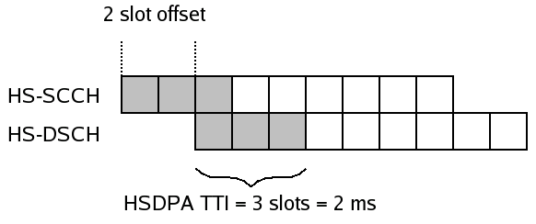
HSDPA channels
User data is sent on High Speed Downlink Shared Channel (HS-DSCH)
Control information is sent on High Speed Common Control Channel (HS-SCCH)
HS-SCCH is sent two slot before HS-DSCH to inform the scheduled UE of the transport format of the incoming transmission on HS-DSCH

Slide 12
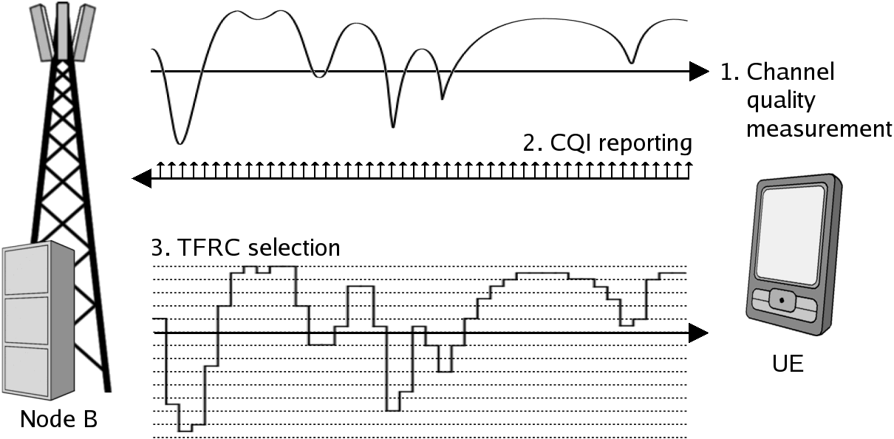
Link Adaptation
UE informs the Node B regularly of its channel quality by CQI messages (Channel Quality Indicator)
TRFC: Transport Format and Resource Combination

Slide 13
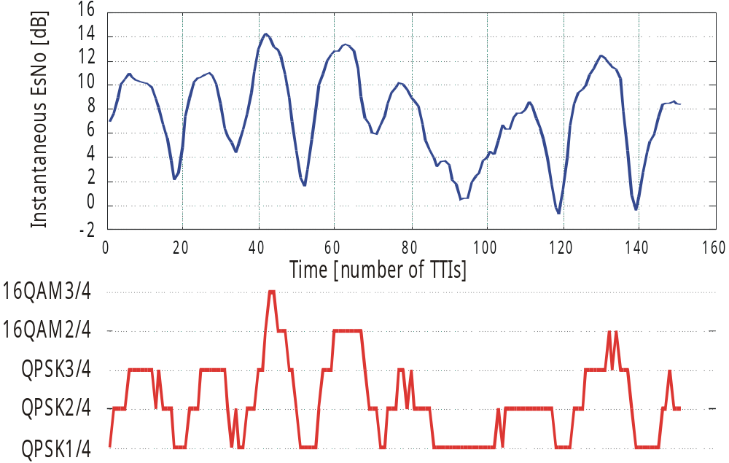
Link Adaptation
Adaptive modulation and higher order modulation (16/64QAM) with HSDPA
Link adaptation adjusts the mode within few ms based on CQI

Slide 14
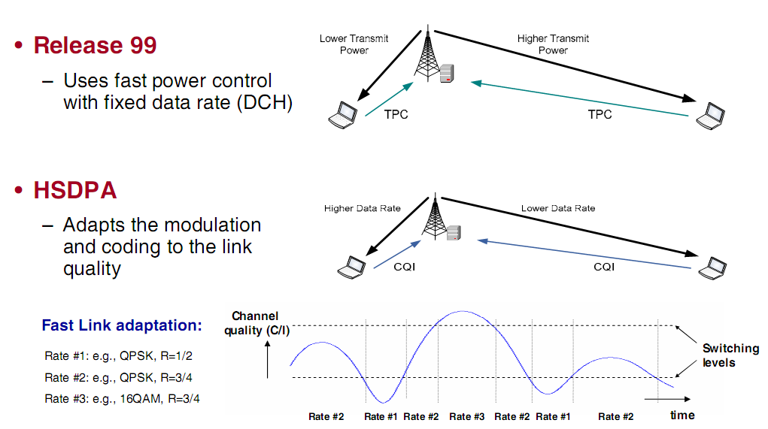
AMC versus Power Control

Slide 15
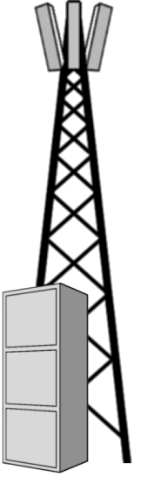

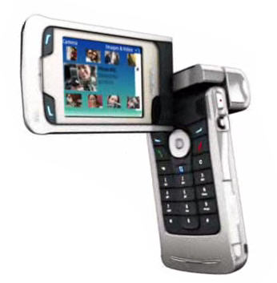
Fast Retransmissions
Rel ‘99
HSPA
RNC
Retransmisson
Packet
Packet
NodeB
RLC ACK/NACK
Retransmisson
UE
Layer 1 ACK/NACK
Radio Link Control (RLC) layer ACK/NACKs also possible with HSPA

Slide 16
Fast Retransmissions
UE
NodeB
RNC
User data
RLC
(Re)transmission
RLC (N)ACK
MAC-d
MAC-hs
Layer1
(Re)transmission
HARQ (N)ACK
MAC-d – Responsible for mapping data from dedicated logical channels (DCCH and DTCH) onto dedicated transport channels (DCH)
MAC-hs maps user data and signaling from DCCH and DTCH onto the shared HS-DSCH transport channels

Slide 17
Fast Retransmissions
Layer 1 signaling indicates the need of retransmission which leads to much faster round trip time that with Rel ‘99
Retransmission procedure with layer 1 retransmissions (HARQ) is done so that decoder does not get rid of the received symbols if the transmission fails but combines them with new transmissions
Retransmissions can operate in two ways:
  Identical retransmissions (soft/chase combining)
  Non-identical retransmissions (incremental redundancy)

Slide 18
Downlink scheduling
NodeB has certain amount of users connected to it and it needs to schedule the different users for transmission in different fractions of time (Transmission Time Intervals)
  Certain fairness for scheduling time for each user should be maintained
  Resources should be utilized in optimal manor
There exists different ways that users can be scheduled in downlink, e.g.
  C/I Max
  Round Robin
  Proportional Fair

Slide 19
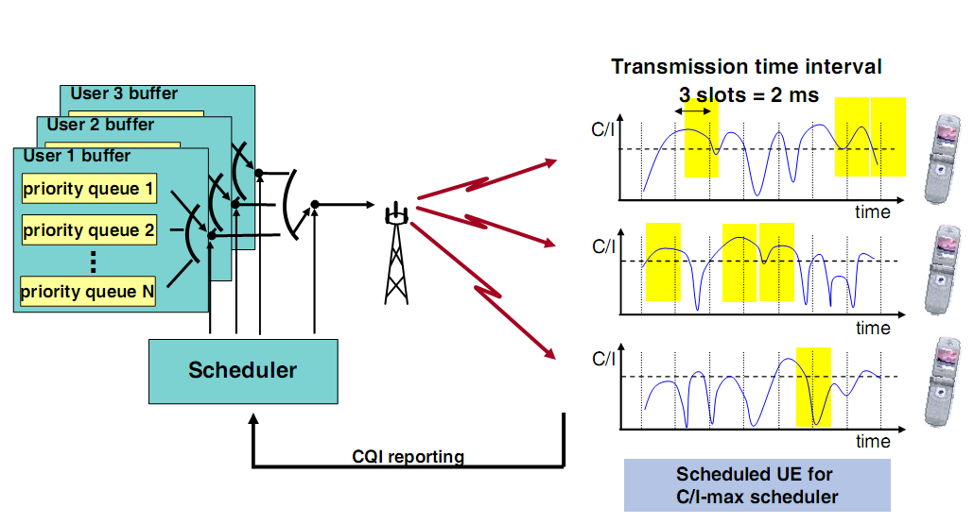
Downlink scheduling

Slide 20
Downlink scheduling
Round Robin (RR)
  Simplest scheduling algorithms
  Assigns users in order i.e. handling all users without priority
  Positive sides
    Easy to implement
    Each user gets served equally
  Negative sides
    No channel conditions are taken into account and thus resources might be wasted

Slide 21
Downlink scheduling (3/5)
Proportional Fair (PF)
  Compromise-based scheduling algorithm
  Based upon maintaining a balance between two competing interests
    Maximize network throughput i.e. users are served in good channel conditions
    Allowing all users at least a minimal level of service

Slide 22
Mobility with HSDPA
Handovers are roughly tradeoff between two issues
  When channel conditions are getting worse, handover to better cell should be made so that packets won’t get lost due to poor channel conditions
  However, each time when the handover is made, transmission buffers in the Node B are flushed resulting to additional delays from RLC level retransmission or disruption of service
When regarding HSDPA, the user can be connected only to one serving HSDPA Node B at the time
  Leading to hard handover when the handover between HSDPA Node Bs is required in contrary to DCH soft handover

Slide 23
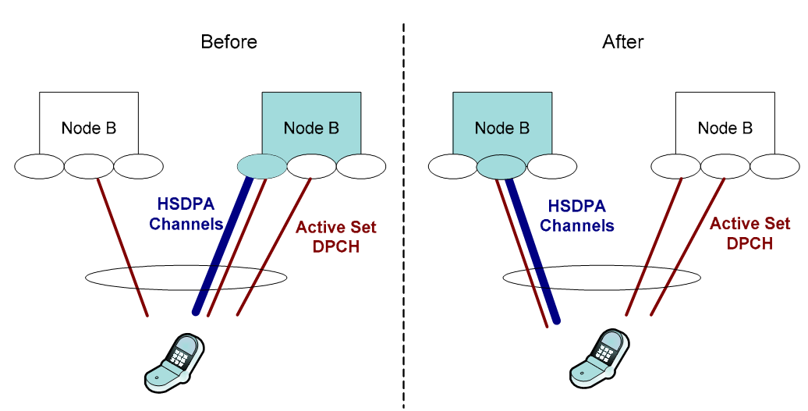
Mobility with HSDPA

Slide 24
Mobility with HSDPA
Even though there is only one serving HS-DSCH cell, the associated DCH itself can be in soft(er) handover and maintain the active set as in Rel’99
Node B,
Serving HSDPA
DCH
DCH
Node B,
Part of DCH active set
HS-SCCH
DCH/HSDPA
UE
DCH

Slide 25
Mobility with HSDPA
HSDPA handover procedure includes following steps
  Serving HS-DSCH cell change procedure is initiated when a link in (DCH) active set becomes higher in strength and stays stronger for certain period of time, referred as time-to-trigger
  If the condition mentioned above is met then the measurement report is sent from the UE to the Node B, which forwards it to the RNC
  If e.g. the admission control requirements are met the RNC can then give the consent for the UE to make the handover by sending so called Signaling Radio Bearer (SRB) (re)configuration message

Slide 26
Mobility with HSDPA
  In the case of intra Node B handover, the HARQ processes (transmissions) and Node B buffers can be maintained and thus there is only minimal interruption in data flow
  However, with inter Node B handover i.e. between Node Bs, the Node B packet buffers are flushed including all unfinished HARQ processes which are belonging to the UE that is handed off

Slide 27
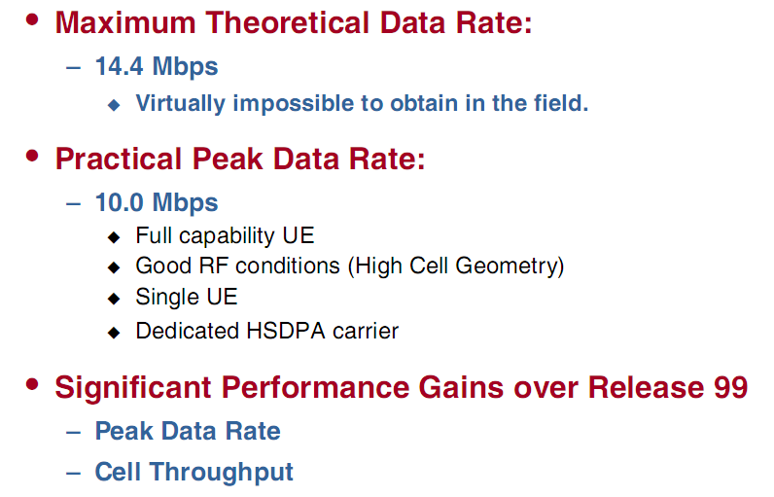
HSDPA Performance Summary

